Slide 1



British Airways
Customer Reviews Analysis

Slide 2
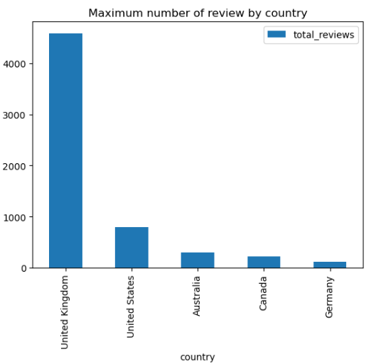
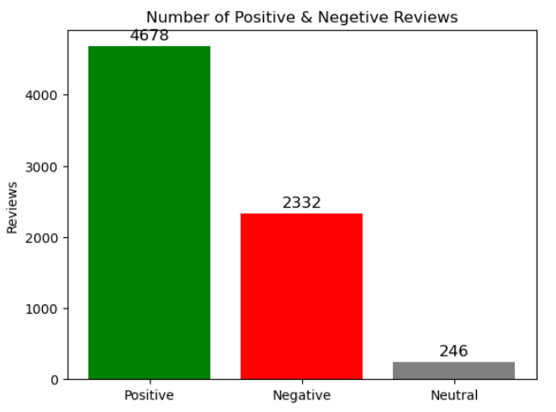
Performance Overview
Average Rating 4.75/10
Maximum Reviews Collected 7270
Reviews from 71 Countries
Customer Sentiment:
Positive Reviews: 4678
Negative Reviews: 2332
Neutral Reviews: 246

Slide 3
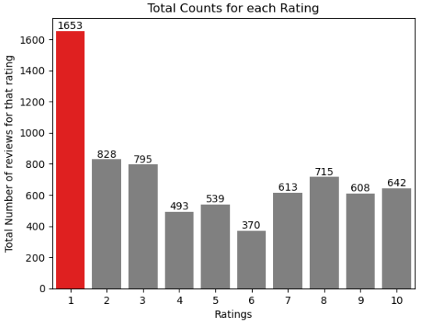
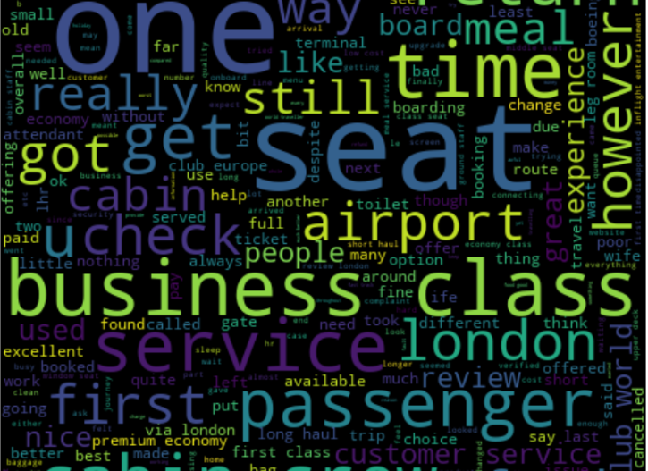
Rating-Based Customer Satisfaction: Insights into Passenger Experiences
7-10 Ratings: Customers who gave ratings between 7 and 10 are generally satisfied with comfortable seats, good inflight entertainment, and descent food quality. This indicates positive experiences in terms of comfort and onboard amenities.
4-6 Ratings: Customers rating between 4 and 6 expressed discontent with small screens, long passport queues, and business class dissatisfaction. This indicates needs for improved entertainment, smoother airport procedures, and better premium services.
1-3 Ratings: Customers giving ratings of 1 to 3 were unhappy with cramped middle seats and small screens. Despite appreciating seats and food quality, negative aspects dominated their experience, highlighting discomfort and screen size.

Slide 4

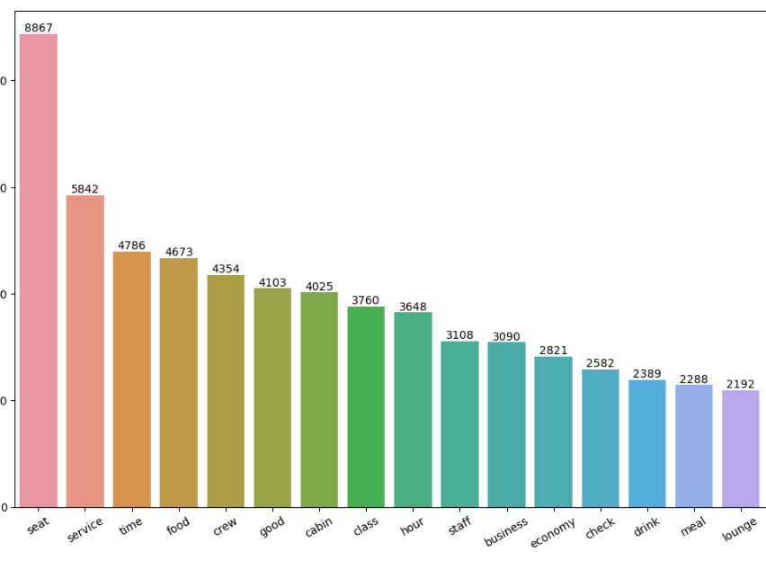
Customer Feedback Insights
Customers appreciated the cabin crew service and the behaviour of the staff. This suggests a positive perception of the airline's service quality.
The general economy seats were well-liked by the customers. However, there seems to be an opportunity to further enhance the overall economy class service and comfort.
Customers traveling in business class are looking for an enhanced experience that provides value for their money. This suggests a need for improvements or additional features to make the business class offering more attractive.
There's a call to improve the inflight entertainment experience, which implies that customers are seeking more engaging entertainment options.

